Slide 1

Extracting and Structuring Web Data
D.W. Embley*, D.M Campbell†, Y.S. Jiang, Y.-K. Ng, R.D. Smith, Li Xu
Department of Computer Science
S.W. Liddle‡
School of Accountancy and Information Systems
Marriott School of Management
D.W. Lonsdale
Department of Linguistics
Brigham Young University
Provo, UT, USA
Funded in part by *Novell, Inc., †Ancestry.com, Inc., ‡Faneuil Research, and
the National Science Foundation (NSF).

Slide 2

Information Exchange
Source
Target

Slide 3
GOAL
Query the Web like we query a database
Example: Get the year, make, model, and price for
1987 or later cars that are red or white.
Year Make Model Price
-----------------------------------------------------------------------
97 CHEVY Cavalier 11,995
94 DODGE 4,995
94 DODGE Intrepid 10,000
91 FORD Taurus 3,500
90 FORD Probe
88 FORD Escort 1,000

Slide 4
PROBLEM
The Web is not structured like a database.
Example:
<html>
<head>
<title>The Salt Lake Tribune Classifieds</title>
</head>
…
<hr>
<h4> ‘97 CHEVY Cavalier, Red, 5 spd, only 7,000 miles on her.
Previous owner heart broken! Asking only $11,995. #1415
JERRY SEINER MIDVALE, 566-3800 or 566-3888</h4>
<hr>
…
</html>

Slide 5
Making the Web Look Like a Database
Web Query Languages
  Treat the Web as a graph (pages = nodes, links = edges).
  Query the graph (e.g., Find all pages within one hop of pages with the words “Cars for Sale”).
Wrappers
  Parse page to extract attribute-value pairs, form records, and either insert them into a database or filter them wrt a query.
    Write parser by hand.
    Use machine learning to discover how to parse a site.
    Develop an application-specific, site-independent ontology to parse a site.
  Query the database or present the filtered result.

Slide 6
Automatic Wrapper Generation
for unstructured record documents, rich in data and narrow in ontological breadth
Application
Ontology
Web Page
Ontology
Parser
Record
Extractor
Constant/Keyword
Matching Rules
Record-Level Objects,
Relationships, and Constraints
Database
Scheme
Unstructured
Record Documents
Constant/Keyword
Recognizer
Data-Record Table
Database-Instance
Generator
Populated
Database

Slide 7
Application Ontology:
Object-Relationship Model Instance
Year
Price
1..*
1..*
Car [-> object];
Car [0..1] has Model [1..*];
Car [0..1] has Make [1..*];
Car [0..1] has Year [1..*];
Car [0..1] has Price [1..*];
Car [0..1] has Mileage [1..*];
PhoneNr [1..*] is for Car [0..1];
PhoneNr [0..1] has Extension [1..*];
Car [0..*] has Feature [1..*];
Make
1..*
has
has
1..*
Mileage
0..1
0..1
0..1
0..1
has
Car
has
0..1
0..*
0..1
has
has
is for
1..*
PhoneNr
Model
1..*
0..1
1..*
has
Feature
1..*
Extension

Slide 8
Application Ontology: Data Frames
Make matches [10] case insensitive
constant
{ extract “chev”; }, { extract “chevy”; }, { extract “dodge”; },
…
end;
Model matches [16] case insensitive
constant
{ extract “88”; context “\bolds\S*\s*88\b”; },
…
end;
Mileage matches [7] case insensitive
constant
{ extract “[1-9]\d{0,2}k”; substitute “k” -> “,000”; },
…
keyword
“\bmiles\b”, “\bmi\b “\bmi.\b”;
end;
...

Slide 9
Ontology Parser
Make : chevy
…
KEYWORD(Mileage) : \bmiles\b
...
create table Car (
Car integer,
Year varchar(2),
… );
create table CarFeature (
Car integer,
Feature varchar(10));
...
Application
Ontology
Ontology
Parser
Constant/Keyword
Matching Rules
Record-Level Objects,
Relationships, and Constraints
Database
Scheme
Object: Car;
...
Car: Year [0..1];
Car: Make [0..1];
…
CarFeature: Car [0..*] has Feature [1..*];

Slide 10
Record Extractor
<html>
…
<h4> ‘97 CHEVY Cavalier, Red, 5 spd, … </h4>
<hr>
<h4> ‘89 CHEVY Corsica Sdn teal, auto, … </h4>
<hr>
….
</html>
Web Page
Record
Extractor
Unstructured
Record Documents
…
#####
‘97 CHEVY Cavalier, Red, 5 spd, …
#####
‘89 CHEVY Corsica Sdn teal, auto, …
#####
...

Slide 11
Constant/Keyword Recognizer
‘97 CHEVY Cavalier, Red, 5 spd, only 7,000 miles on her.
Previous owner heart broken! Asking only $11,995. #1415
JERRY SEINER MIDVALE, 566-3800 or 566-3888
Descriptor/String/Position(start/end)
Year|97|2|3
Make|CHEV|5|8
Make|CHEVY|5|9
Model|Cavalier|11|18
Feature|Red|21|23
Feature|5 spd|26|30
Mileage|7,000|38|42
KEYWORD(Mileage)|miles|44|48
Price|11,995|100|105
Mileage|11,995|100|105
PhoneNr|566-3800|136|143
PhoneNr|566-3888|148|155
Constant/Keyword
Matching Rules
Unstructured
Record Documents
Constant/Keyword
Recognizer
Data-Record Table

Slide 12
Heuristics
Keyword proximity
Subsumed and overlapping constants
Functional relationships
Nonfunctional relationships
First occurrence without constraint violation

Slide 13
Keyword Proximity
Year|97|2|3
Make|CHEV|5|8
Make|CHEVY|5|9
Model|Cavalier|11|18
Feature|Red|21|23
Feature|5 spd|26|30
Mileage|7,000|38|42
KEYWORD(Mileage)|miles|44|48
Price|11,995|100|105
Mileage|11,995|100|105
PhoneNr|566-3800|136|143
PhoneNr|566-3888|148|155
Δ = 2
Δ = 52
'97 CHEVY Cavalier, Red, 5 spd, only 7,000 miles on her. Previous owner heart broken! Asking only $11,995. #1415. JERRY SEINER MIDVALE, 566-3800 or 566-3888

Slide 14
Subsumed/Overlapping Constants
Year|97|2|3
Make|CHEV|5|8
Make|CHEVY|5|9
Model|Cavalier|11|18
Feature|Red|21|23
Feature|5 spd|26|30
Mileage|7,000|38|42
KEYWORD(Mileage)|miles|44|48
Price|11,995|100|105
Mileage|11,995|100|105
PhoneNr|566-3800|136|143
PhoneNr|566-3888|148|155
'97 CHEVY Cavalier, Red, 5 spd, only 7,000 miles. Previous owner heart broken! Asking only $11,995. #1415. JERRY SEINER MIDVALE, 566-3800 or 566-3888

Slide 15
Functional Relationships
Year|97|2|3
Make|CHEV|5|8
Make|CHEVY|5|9
Model|Cavalier|11|18
Feature|Red|21|23
Feature|5 spd|26|30
Mileage|7,000|38|42
KEYWORD(Mileage)|miles|44|48
Price|11,995|100|105
Mileage|11,995|100|105
PhoneNr|566-3800|136|143
PhoneNr|566-3888|148|155
'97 CHEVY Cavalier, Red, 5 spd, only 7,000 miles on her. Previous owner heart broken! Asking only $11,995. #1415. JERRY SEINER MIDVALE, 566-3800 or 566-3888

Slide 16
Nonfunctional Relationships
Year|97|2|3
Make|CHEV|5|8
Make|CHEVY|5|9
Model|Cavalier|11|18
Feature|Red|21|23
Feature|5 spd|26|30
Mileage|7,000|38|42
KEYWORD(Mileage)|miles|44|48
Price|11,995|100|105
Mileage|11,995|100|105
PhoneNr|566-3800|136|143
PhoneNr|566-3888|148|155
'97 CHEVY Cavalier, Red, 5 spd, only 7,000 miles on her. Previous owner heart broken! Asking only $11,995. #1415. JERRY SEINER MIDVALE, 566-3800 or 566-3888

Slide 17
First Occurrence without Constraint Violation
Year|97|2|3
Make|CHEV|5|8
Make|CHEVY|5|9
Model|Cavalier|11|18
Feature|Red|21|23
Feature|5 spd|26|30
Mileage|7,000|38|42
KEYWORD(Mileage)|miles|44|48
Price|11,995|100|105
Mileage|11,995|100|105
PhoneNr|566-3800|136|143
PhoneNr|566-3888|148|155
'97 CHEVY Cavalier, Red, 5 spd, only 7,000 miles on her. Previous owner heart broken! Asking only $11,995. #1415. JERRY SEINER MIDVALE, 566-3800 or 566-3888

Slide 18
Database-Instance Generator
Year|97|2|3
Make|CHEV|5|8
Make|CHEVY|5|9
Model|Cavalier|11|18
Feature|Red|21|23
Feature|5 spd|26|30
Mileage|7,000|38|42
KEYWORD(Mileage)|miles|44|48
Price|11,995|100|105
Mileage|11,995|100|105
PhoneNr|566-3800|136|143
PhoneNr|566-3888|148|155
Record-Level Objects,
Relationships, and Constraints
Database
Scheme
Data-Record Table
Database-Instance
Generator
Populated
Database
insert into Car values(1001, “97”, “CHEVY”, “Cavalier”,
“7,000”, “11,995”, “556-3800”)
insert into CarFeature values(1001, “Red”)
insert into CarFeature values(1001, “5 spd”)

Slide 19
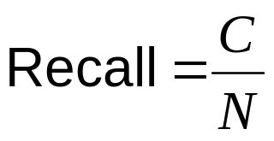
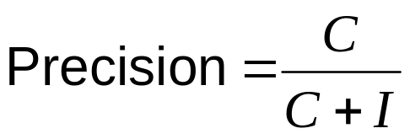
Recall & Precision
N = number of facts in source
C = number of facts declared correctly
I = number of facts declared incorrectly
(of facts available, how many did we find?)
(of facts retrieved, how many were relevant?)

Slide 20
Results: Car Ads
Salt Lake Tribune
Recall % Precision %
Year 100 100
Make 97 100
Model 82 100
Mileage 90 100
Price 100 100
PhoneNr 94 100
Extension 50 100
Feature 91 99
Training set for tuning ontology: 100
Test set: 116

Slide 21
Car Ads: Comments
Unbounded sets
  missed: MERC, Town Car, 98 Royale
  could use lexicon of makes and models
Unspecified variation in lexical patterns
  missed: 5 speed (instead of 5 spd), p.l (instead of p.l.)
  could adjust lexical patterns
Misidentification of attributes
  classified AUTO in AUTO SALES as automatic transmission
  could adjust exceptions in lexical patterns
Typographical errors
  “Chrystler”, “DODG ENeon”, “I-15566-2441”
  could look for spelling variations and common typos

Slide 22
Results: Computer Job Ads
Los Angeles Times
Recall % Precision %
Degree 100 100
Skill 74 100
Email 91 83
Fax 100 100
Voice 79 92
Training set for tuning ontology: 50
Test set: 50

Slide 23
Obituaries
(A More Demanding Application)
Multiple
Dates
Our beloved Brian Fielding Frost,
age 41, passed away Saturday morning,
March 7, 1998, due to injuries sustained
in an automobile accident. He was born
August 4, 1956 in Salt Lake City, to
Donald Fielding and Helen Glade Frost.
He married Susan Fox on June 1, 1981.
He is survived by Susan; sons Jord-
dan (9), Travis (8), Bryce (6); parents,
three brothers, Donald Glade (Lynne),
Kenneth Wesley (Ellen), …
Funeral services will be held at 12
noon Friday, March 13, 1998 in the
Howard Stake Center, 350 South 1600
East. Friends may call 5-7 p.m. Thurs-
day at Wasatch Lawn Mortuary, 3401
S. Highland Drive, and at the Stake
Center from 10:45-11:45 a.m.
Names
Family
Relationships
Multiple
Viewings
Addresses

Slide 24
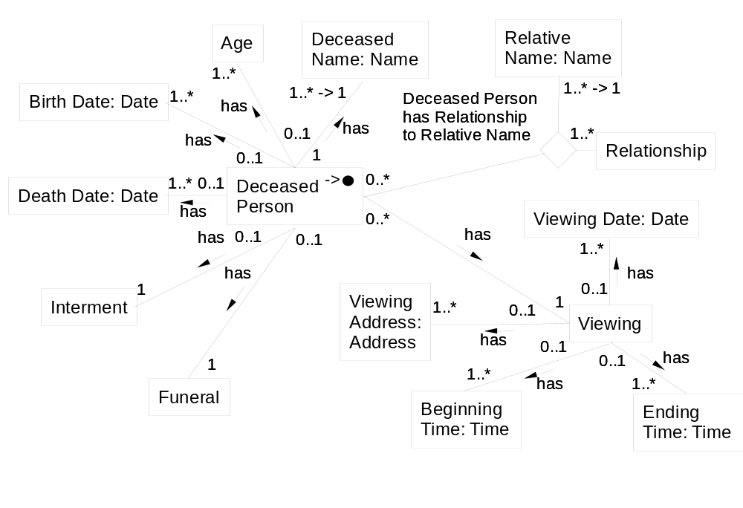
Obituary Ontology
(partial)

Slide 25
Data Frames
Lexicons & Specializations
Name matches [80] case sensitive
constant
{ extract First, “\s+”, Last; },
…
{ extract “[A-Z][a-zA-Z]*\s+([A-Z]\.\s+)?”, Last; },
…
lexicon
{ First case insensitive; filename “first.dict”; },
{ Last case insensitive; filename “last.dict”; };
end;
Relative Name matches [80] case sensitive
constant
{ extract First, “\s+\(“, First, “\)\s+”, Last; substitute “\s*\([^)]*\)” -> “”; }
…
end;
...

Slide 26
Keyword Heuristics
Singleton Items
RelativeName|Brian Fielding Frost|16|35
DeceasedName|Brian Fielding Frost|16|35
KEYWORD(Age)|age|38|40
Age|41|42|43
KEYWORD(DeceasedName)|passed away|46|56
KEYWORD(DeathDate)|passed away|46|56
BirthDate|March 7, 1998|76|88
DeathDate|March 7, 1998|76|88
IntermentDate|March 7, 1998|76|98
FuneralDate|March 7, 1998|76|98
ViewingDate|March 7, 1998|76|98
...

Slide 27
Keyword Heuristics
Multiple Items
…
KEYWORD(Relationship)|born … to|152|192
Relationship|parent|152|192
KEYWORD(BirthDate)|born|152|156
BirthDate|August 4, 1956|157|170
DeathDate|August 4, 1956|157|170
IntermentDate|August 4, 1956|157|170
FuneralDate|August 4, 1956|157|170
ViewingDate|August 4, 1956|157|170
BirthDate|August 4, 1956|157|170
RelativeName|Donald Fielding|194|208
DeceasedName|Donald Fielding|194|208
RelativeName|Helen Glade Frost|214|230
DeceasedName|Helen Glade Frost|214|230
KEYWORD(Relationship)|married|237|243
...

Slide 28
Results: Obituaries
Arizona Daily Star
Recall % Precision %
DeceasedName* 100 100
Age 86 98
BirthDate 96 96
DeathDate 84 99
FuneralDate 96 93
FuneralAddress 82 82
FuneralTime 92 87
…
Relationship 92 97
RelativeName* 95 74
*partial or full name
Training set for tuning ontology: ~ 24
Test set: 90

Slide 29
Results: Obituaries
Salt Lake Tribune
Recall % Precision %
DeceasedName* 100 100
Age 91 95
BirthDate 100 97
DeathDate 94 100
FuneralDate 92 100
FuneralAddress 96 96
FuneralTime 97 100
…
Relationship 81 93
RelativeName* 88 71
*partial or full name
Training set for tuning ontology: ~ 12
Test set: 38

Slide 30
“Open” Problems
Record-Boundary Detection
Record Reconfiguration
Page/Ontology Matching
Form Interfaces
Rapid Ontology Construction, Evolution, and Improvement

Slide 31
Record-Boundary Detection:
High Fan-Out Heuristic
<html>
<head>
<title>The Salt Lake Tribune … </title>
</head>
<body bgcolor=“#FFFFFF”>
<h1 align=”left”>Domestic Cars</h1>
…
<hr>
<h4> ‘97 CHEVY Cavalier, Red, … </h4>
<hr>
<h4> ‘89 CHEVY Corsica Sdn … </h4>
<hr>
…
</body>
</html>
html
head
body
title
h1
… hr h4 hr h4 hr ...

Slide 32
Record-Boundary Detection:
Record-Separator Heuristics
Identifiable “separator” tags
Highest-count tag(s)
Interval standard deviation
Ontological match
Repeating tag patterns
Example:
…
<hr>
<h4> ‘97 CHEVY Cavalier, Red, 5 spd, <i>only 7,000 miles</i>
on her. Asking <i>only $11,995</i>. … </h4>
<hr>
<h4> ‘89 CHEV Corsica Sdn teal, auto, air, <i>trouble free</i>.
Only $8,995 … </h4>
<hr>
...

Slide 33
Record-Boundary Detection:
Consensus Heuristic
Certainty is a generalization of: C(E₁) + C(E₂) - C(E₁)C(E₂).
C denotes certainty and E_{i} is the evidence for an observation.
Our certainties are based on observations from 10 different
sites for 2 different applications (car ads and obituaries)
Correct Tag Rank
Heuristic 1 2 3 4
IT 96% 4%
HT 49% 33% 16% 2%
SD 66% 22% 12%
OM 85% 12% 2% 1%
RP 78% 12% 9% 1%

Slide 34
Record-Boundary Detection: Results
Heuristic Success Rate
IT 95%
HT 45%
SD 65%
OM 80%
RP 75%
Consensus 100%
4 different applications (car ads, job ads, obituaries,
university courses) with 5 new/different sites for each
application

Slide 35
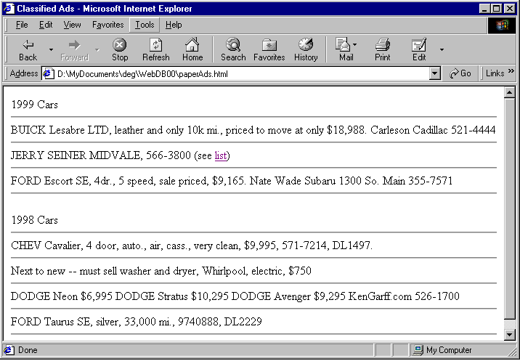
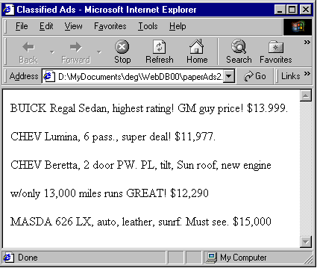
Record Reconfiguration:
Problems Encountered
factored
split
joined
interspersed
off-page

Slide 36
Record Reconfiguration:
Proposed Solution
Maximize a Record-Recognition Measure
Improvements:
  Split joined records
  Distribute factored values
  Link off-page information
  Join split records
  Discard interspersed records

Slide 37
Record Reconfiguration:
Use Record-Recognition Measures based on Vector Space Modeling
VSM
VSM Measures
Ontology Vector <f₁, … f_{n}>
Document Vector <f₁, … f_{n}>
DV
Cosine
Vector Length
OV

Slide 38
Record Reconfiguration:
Test Set Characteristics
30 pre-selected documents
Characteristics
  8 contained only regular car ads.
  13 contained inside-boundary joined car ads all with inside-boundary factored values.
  1 contained outside-boundary factored values.
  13 contained interspersed non-car-ads.
  None contained off-page or split ads.

Slide 39
Record Reconfiguration:
Results
Correctly reconfigured 91% (of 304)
  36 false drops
  11 car ads improperly discarded (value-recognition problem)
  25 car ads improperly reconfigured
    20 ads with identical phone numbers on every 5th
    5 inside-boundary ads not split (missing years & makes; not all models recognized)
Correctly discarded 94% (of 47)
  3 false positives
  all snowmobile ads
Correctly produced 97% (of 1,077)

Slide 40
Page/Ontology Matching:
Recognition Heuristics
Density Heuristic
  Lots of constant and keyword matches.
  Total matched characters / total characters
Expected-Values Heuristic
  Recognized constants appear in expected frequencies.
  VSM cosine measure
Grouping Heuristic
  Recognized constants are grouped as expected.
  Number of distinct “one-max” values: ordered & grouped by expected size of group

Slide 41
Page/Ontology Matching:
Machine-Learned Combined Heuristic
A heuristic triple (H₁, H₂, H₃) represents a document.
Training set: 20 positive examples; 30 negative.
C4.5 machine-learning algorithm produced decision trees.
Car Ads
Obituaries
Universal
H₂
H₂
H₃
>0.88
>0.68
>0.63
no
yes
no
H₁
yes
H₁
>0.22
>0.37
no
yes
no
H₂
>0.63
no
yes

Slide 42
Page/Ontology Matching: Results
Car Ads
  Rule 1 correctly matched 97% (of 11 positive and 19 negative)
  One false negative: “ROBERTS FORDCHRYSLERPLYMOUTHJEEPUSED CARS99 Plymouth Breeze $12,99599 Plymouth Neon $11,99599 Ford … theHomer Adams Pkwy., Alton466-7220”
Obituaries
  Rule 2 correctly matched 97% (of 10 positive and 20 negative)
  One false positive: Missing People
Singleton Obituaries – marginal for famous people

Slide 43
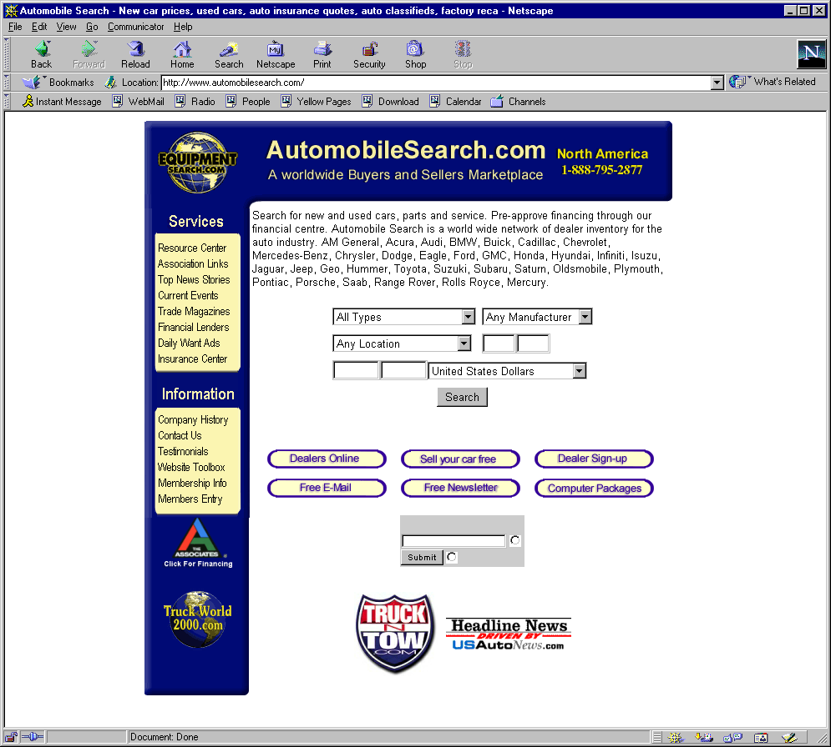
Form Interfaces

Slide 44
Form Interfaces: Questions
What’s the best way to automate retrieval of data behind Web forms?
  Can we match a form to an ontology?
  Can we learn how to fill in a form for a given (ontology) query?
  Is it reasonable to try to retrieve all the data behind a form?
Can we automatically:
  Fill in Web forms?
  Extract information behind forms?
  Screen out error messages and inapplicable Web pages?
  Eliminate duplicate data?

Slide 45
Rapid Ontology Construction,
Evolution, and Improvement
Is it possible to (semi)automate the construction of an application ontology?
  Can we build tools to help users create an ontology? (yes)
  Can we assemble components from a knowledgebase of ontological components?
  Can we use machine learning?
Can we use automated construction techniques to aid in ontology evolution and improvement?

Slide 46
Conclusions
Given an ontology and a Web page with multiple records, it is possible to extract and structure the data automatically.
Recall and Precision results are encouraging.
  Car Ads: ~ 94% recall and ~ 99% precision
  Job Ads: ~ 84% recall and ~ 98% precision
  Obituaries: ~ 90% recall and ~ 95% precision (except on names: ~ 73% precision)
Resolution of Problems
  Record-Boundary Detection – excellent if records nicely separated
  Record Reconfiguration – excellent for known patterns
  Page/Ontology matching – excellent for multiple-record documents
Open Problems
  Extraction of data behind forms
  Rapid ontology construction
http://www.deg.byu.edu/

